Slide 1
Standards Guide
Retail

Slide 2
Table of Contents:
How to board fold tops
Folding: How to quarter and half fold tops and bottoms
Hanging standards for shirts and bottoms
Merchandising Tips and Tricks:
Color blocking
Outfitting presentations to drive revenue through merchandising
Detailing
Accessories
Styling mannequins
Sensor guidelines
Sale guidelines and execution
Supplies needed to execute and maintain standards

Slide 3
Board Folding

Slide 4
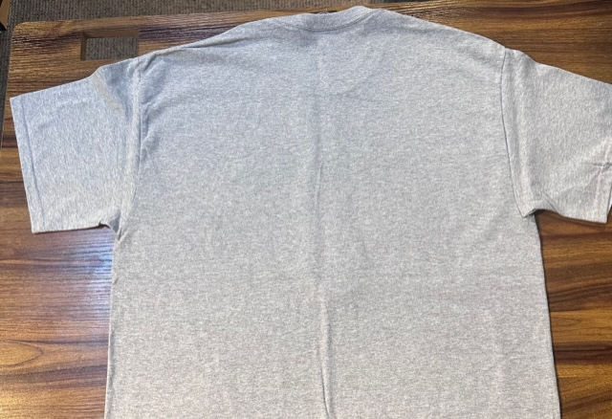
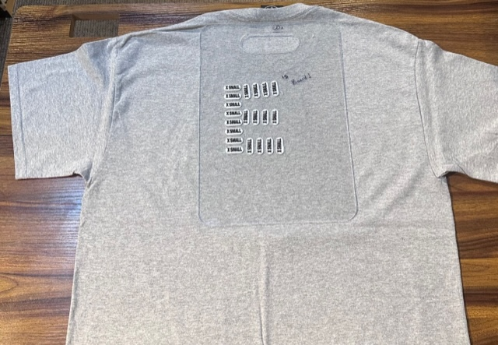
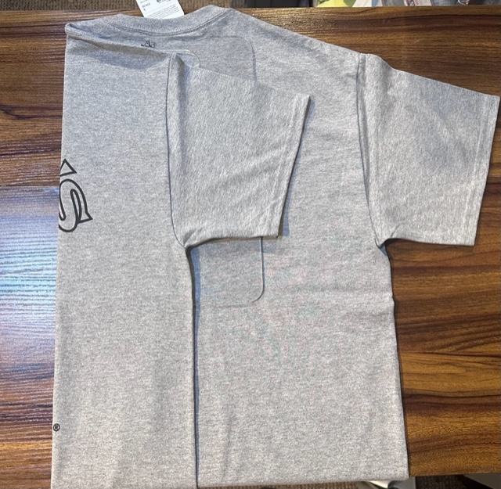
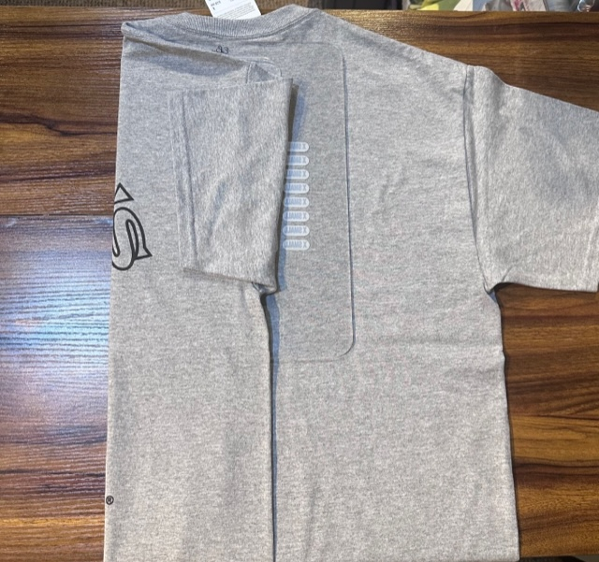
Board Folding Tops:
Lay top facedown and flattened out
Place folding board directly below the neck of the shirt
While holding the board in place, pull one half of the shirt tightly across the board
Fold the sleeve in half before beginning the same process on the other side of the shirt
*This technique is most commonly used in the core tower or wall

Slide 5
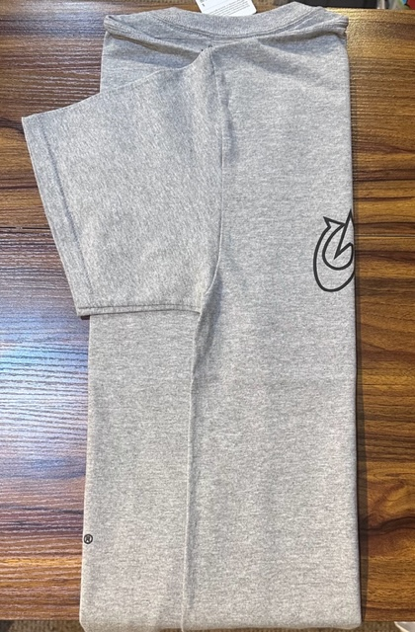
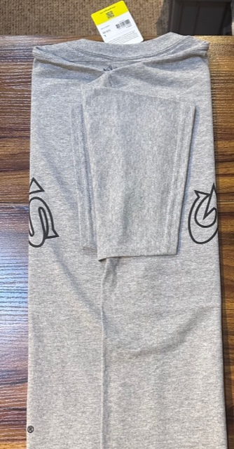
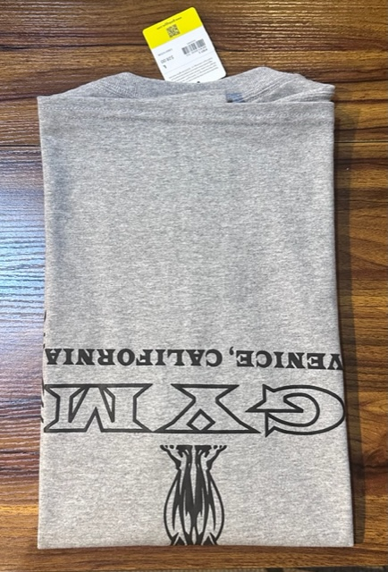
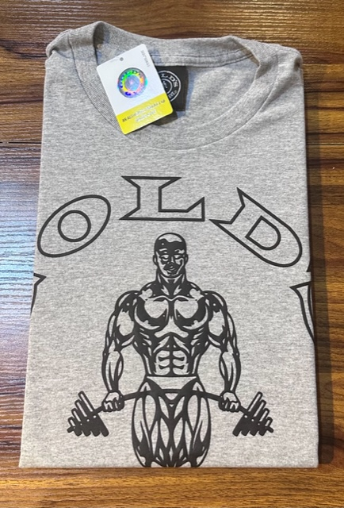
Continued:
Pull the other side of the shift tightly across the board, repeating the previous step
Fold the sleeve in half again, so the excess fabric does not hang over the side of the shirt
While the board is still in place, fold the shirt in half so the hem is directly below the collar
With the board still in place, flip the shirt right-side up

Slide 6
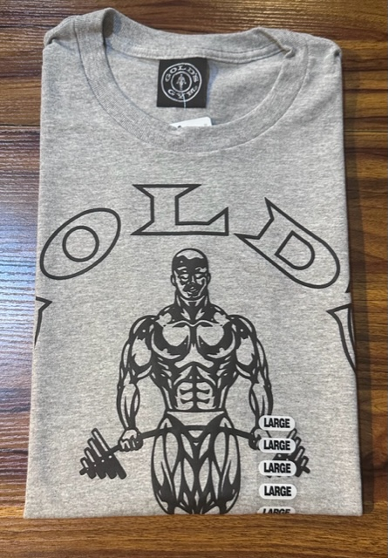
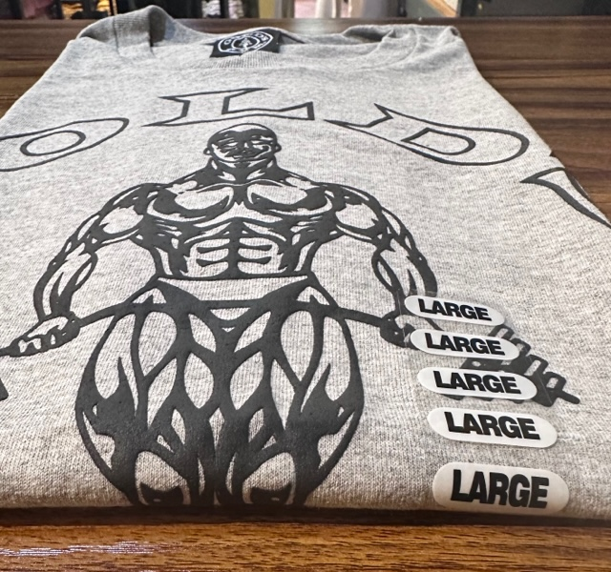
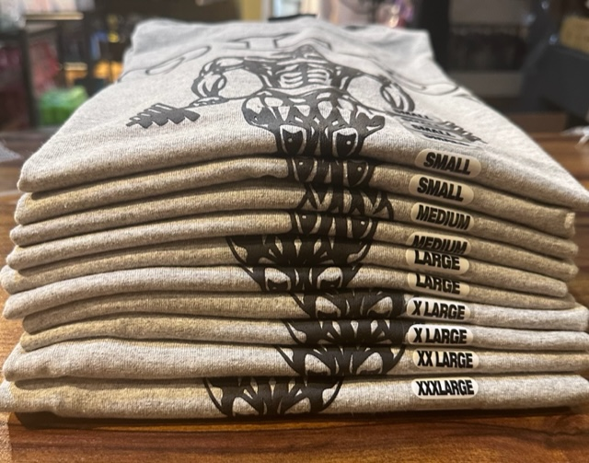
Continued:
Now remove the folding board from the collar of the shirt .Repeat the same steps until you have a full size run represented
Once you have a full size run folded (reference the size run slide) and ensure all size stickers are lined up with the size visible to the customer on the front of the shirt. Also, ensure all shirts are lined up *You should be able to put the folding board on the front of the stack, and all shirts will touch the board if your standards are strong
With the board still in place, so the fabric stays taut, use two fingers from the right side of the shirt to measure where to place the corresponding size sticker *tuck price tag into collar of the shirt with the price facing up so a customer can easily see the price if looking

Slide 7
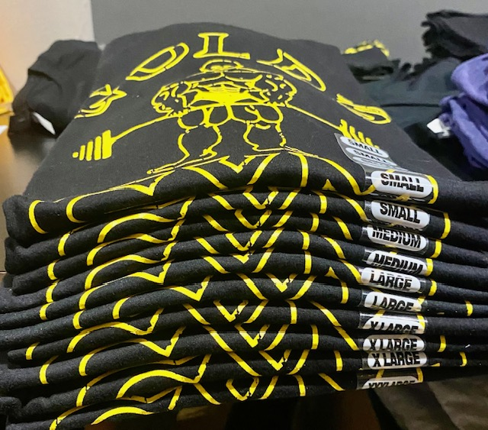
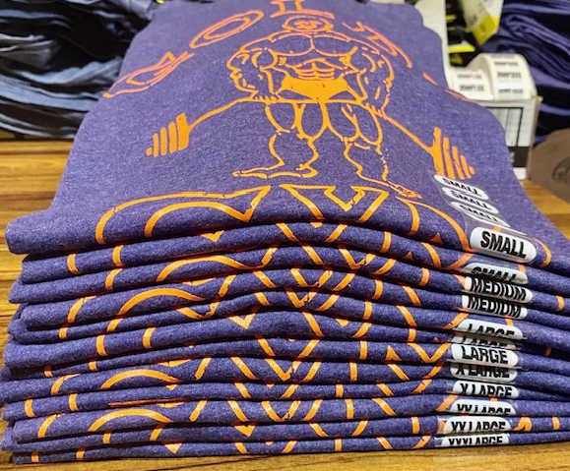
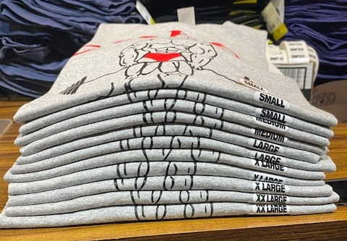
Examples of strong standards for core tower/core wall:
As suggested, test your stack standards by holding the front of the folding board to the front of the stack to ensure that all shirts touch the board, which means the shirts are stacked to standard
Align all size stickers on the right side of the shirts *use two fingers from the right to space and place the sticker
Having the same part of the graphic showing on the front each shirt in the stack, creates a stronger illusion of strong standards

Slide 8
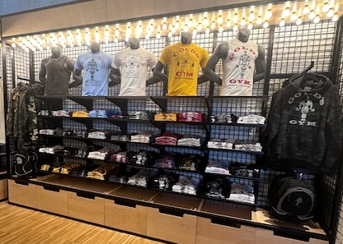
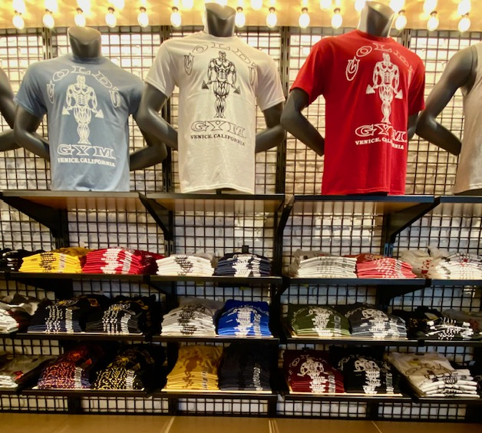
Example of a Set Core Product Presentation:

Slide 9
Folding

Slide 10
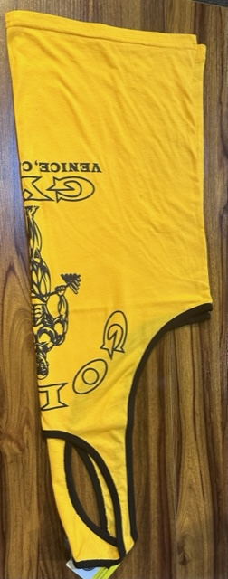
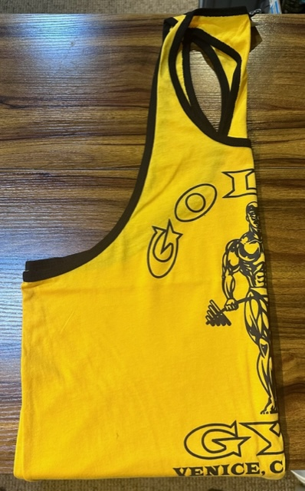
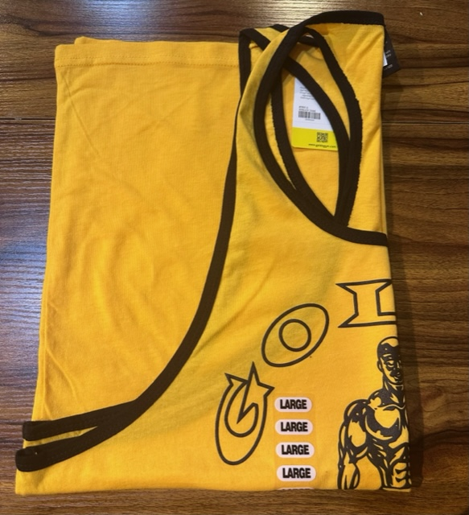
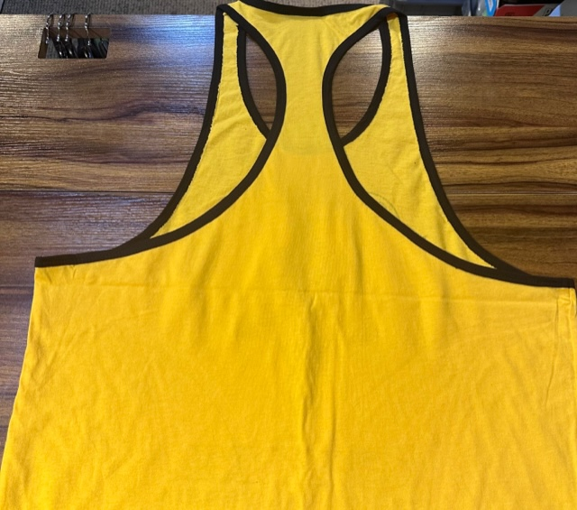
Quarter Folding Tops:
Lay the top face down and flat on a surface
Same as with board folding, use two fingers from the right of the shirt to place the size sticker
Fold the shirt in half vertically from right to left * it is important that this fold is vertical, not horizonal, as if it is not, it will create a split in the shirt, which not only makes it hard to shop, but also it will prevent you from being able to place a size sticker on each shirt
Next, fold the shift in half again, this time horizontally *the hem of the shirt should not go above the top of the shirt

Slide 11
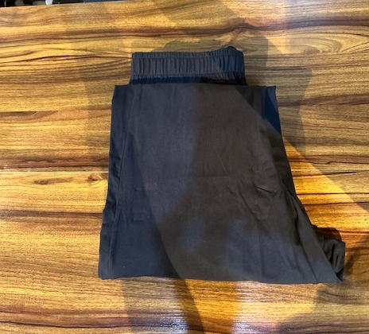
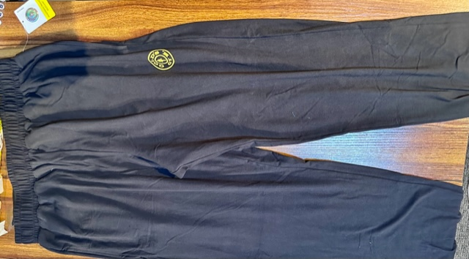
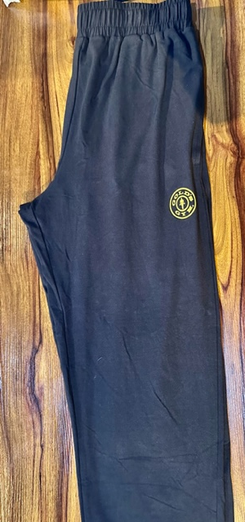
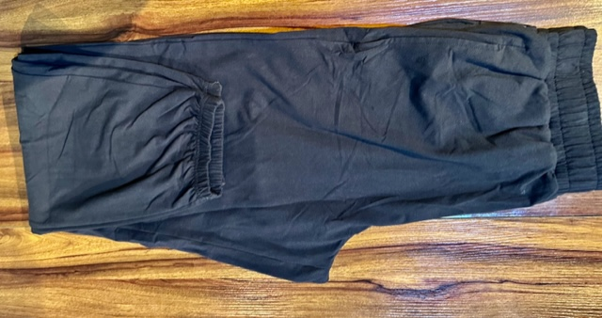
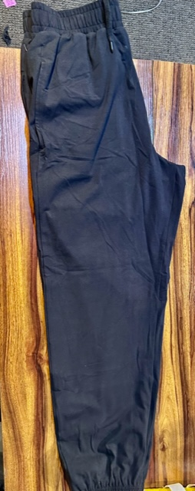
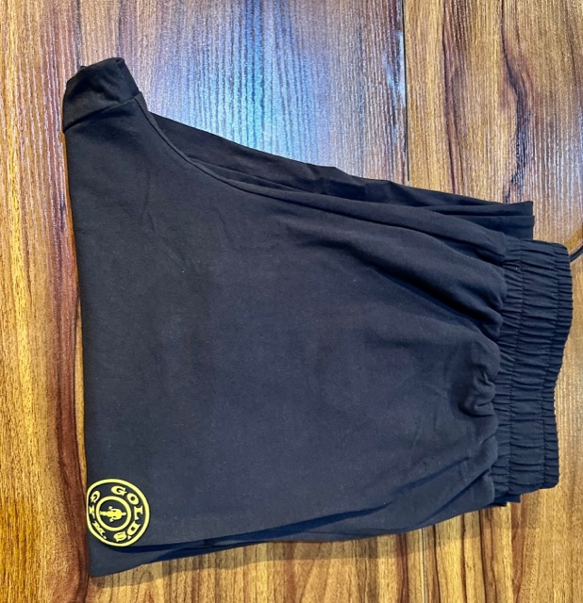
Quarter Folding Bottoms:
This is where the fold from the previous step should land directly below the waistband
Fold the bottom up in half again, directly below the waistband of the pant
Lay the bottom flat on a surface
Fold the bottom in half vertically, with the crotch facing the left side and then flip the bottom upside down for the next fold
Fold the ankle/bottom of pant a few inches below the crotch area of the pant *the strategy of where the first fold hits (a few inches shy of halfway up the pant, is done strategically so the stack of bottoms lays as flat as possible and doesn’t topple
Flip the bottom right-side up and ensure that the logo is visible, if possible

Slide 12
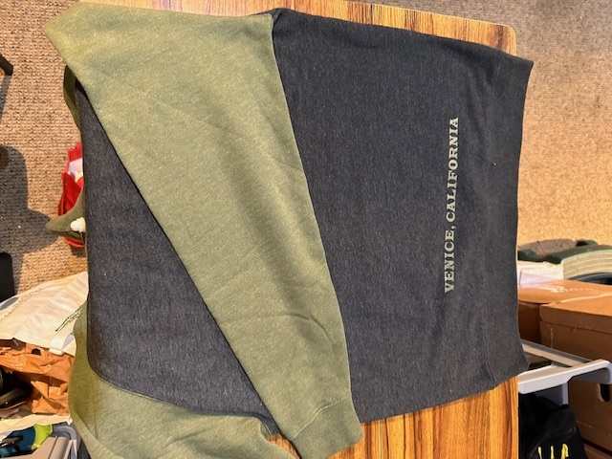
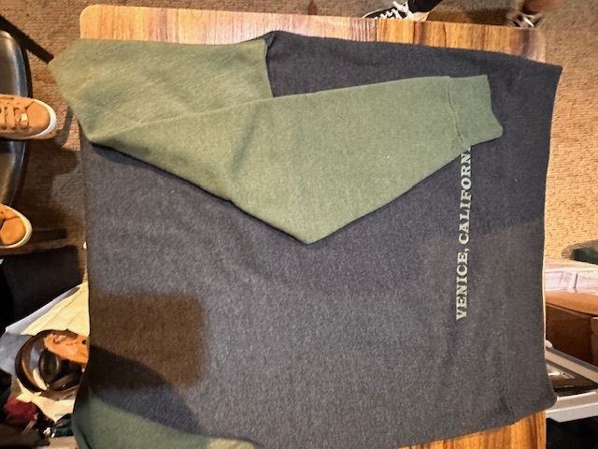
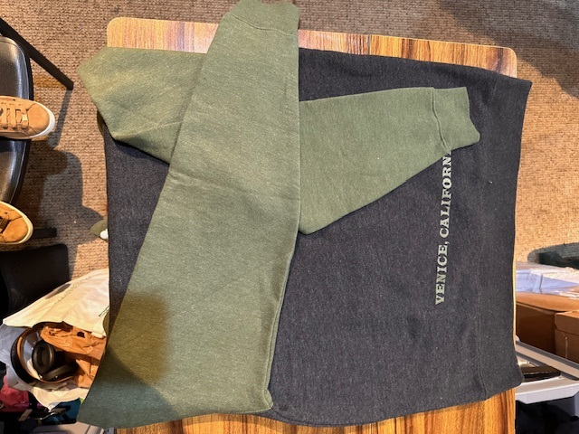
Half Folding (hoodies/long sleeve tops):
Fold the sleeve back towards the side it came from and down like a “checkmark”
Pull the other sleeve across and down in the same “checkmark” shown in the previous two steps
Lay the hoodie or top facedown on a flat surface and pull one sleeve directly across to the opposite side of top

Slide 13
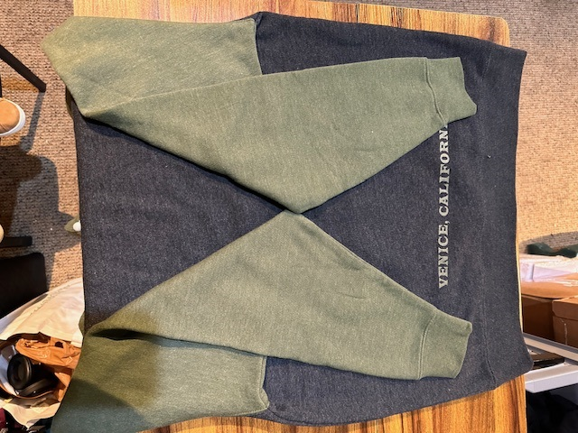
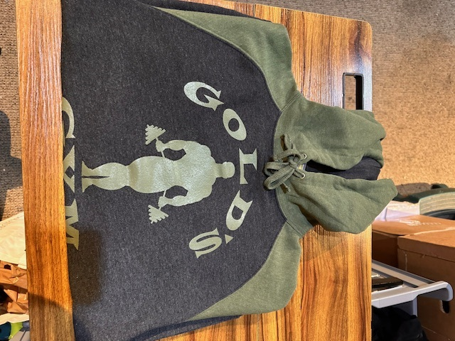
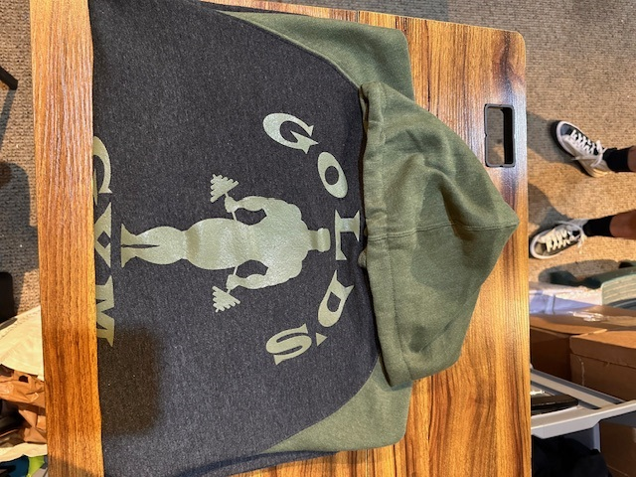
Half Folding (hoodies/long sleeve tops) Continued:
Pull the hood taut and lay the hood flat so that the stack lays flat and doesn’t topple when stacked *use the same size sticker guidelines when half folding hoodies/long-sleeve tops
*Note that a short sleeve or tank top would be folded the same way, the only difference would be that the other tops would not need the “checkmark” fold that a long-sleeved top needs to lay flat
With both sleeves folded into the “checkmark” then fold the top in half from the bottom
Flip the top over, right-side up *ensure the hem doesn’t go above the collar/hood of the top

Slide 14
Additional Folding Notes:
Note that all tips can be applied to other variations when folding. For example, if you want to board fold a long sleeve top, the checkmark tip would apply with board folding, as the intention of the “checkmark” is so that each top lays as flat as possible and so that the fabric does not go beyond boarders of the top or bottom (protect the aesthetic, and makes more space for items to fit in the intended space)
Making sure when quarter folding tops, the first fold is ALWAYS vertical before horizontal, if this step is not done properly, it will create a split in the shirt, which not only makes it hard for a customer to shop, as you cannot tell when one top starts and the other stops, but also it will prevent you from being able to place a size sticker on each shirt

Slide 15
Hanging

Slide 16
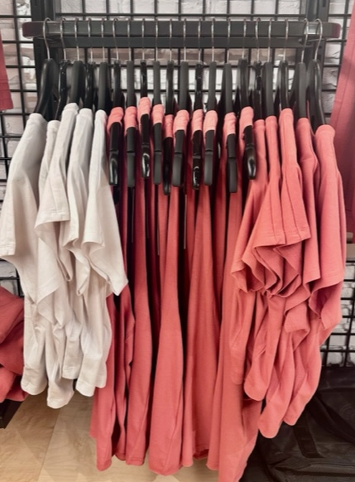
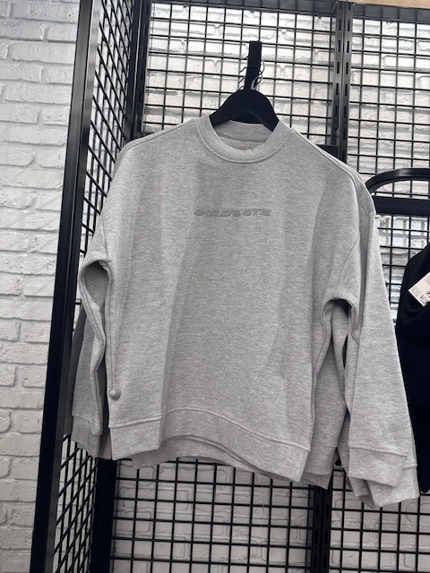
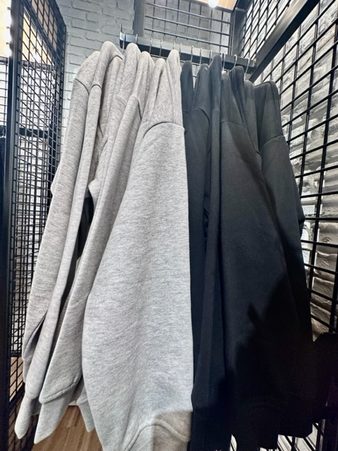
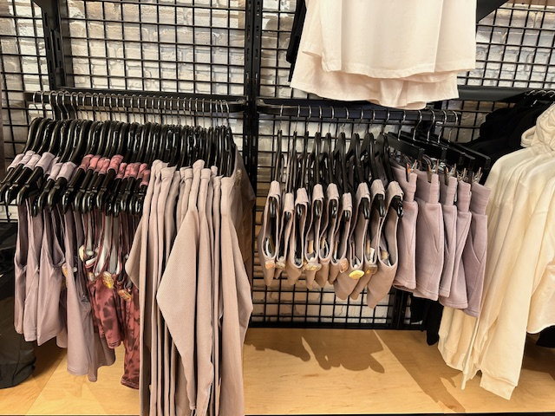
Hanging Standards: Spacing and Size Runs
Size run:
Standard:
1 xs
2 s
2 m
2 lg
2 xl
1 xxl
*When placing two items on a face out or when hanging thinker product, such as jackets, it is okay to place 1 of each size out to make space and protect ease of shopping for the customer
When placing two items on a face out, which should be the max number of colors represented, place the darker color behind the lighter color, as long as it does not negatively impact the color story in the wall
There should usually not be more than 3 items in a single side hang bar and the standard size run, or one of each size, is what should be placed on the sales floor *Note all tags are tucked and hanger spacing is protected in all standards
When hanging product, ensure that each hanger is evenly spaced on the rack, face out, or side hang bar

Slide 17
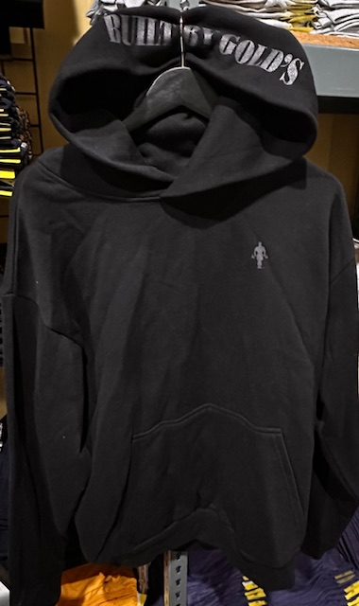
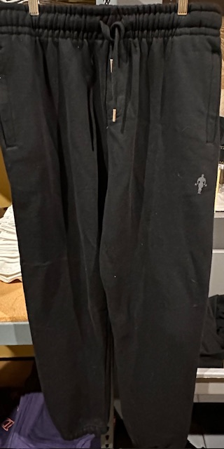
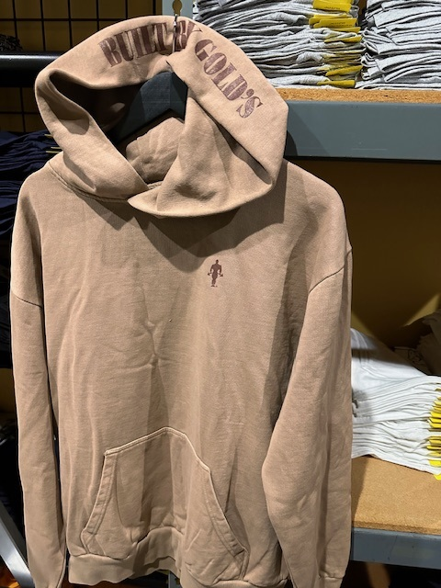
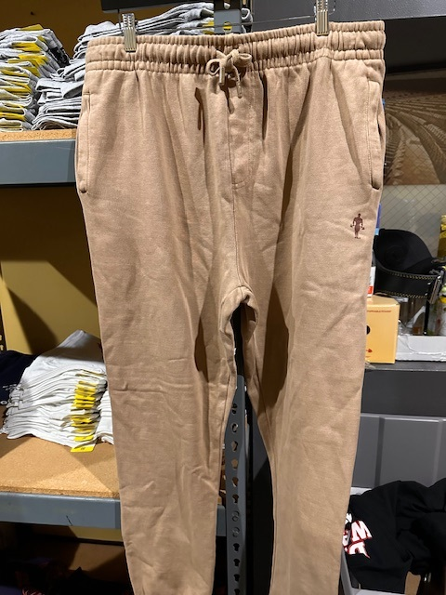
Hanging Guide (Bottoms and Tops):
“Pop” the hood, as previously mentioned in prior slides, to not only highlight the detailing on the hood, but also to make more space for hanging product on the salesfloor
Pull the waistband taut and slide the hanger clips to the end of the hanger, and with the band pulled taut, clip the band as straight as possible *Not only does it look aesthetically strong, but also, it creates more hanging space to place a full size run, that is easy to shop out on the salesfloor
Notice that the price tag is tucked inside of the hoodie and the strings are neatly tied up, so they are not just haphazardly hanging and blocking the logo
Notice the stings tied up in this photo (vs. the black bottoms pictured on this slide) and the aesthetic difference

Slide 18
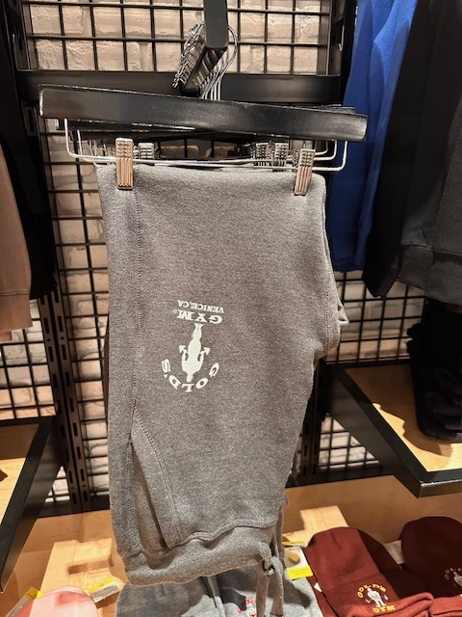
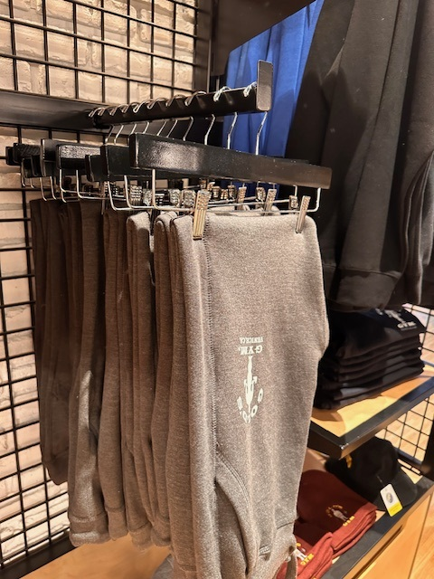
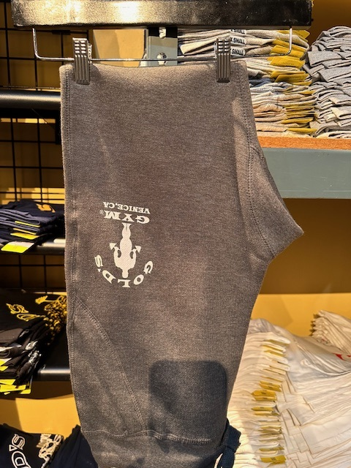
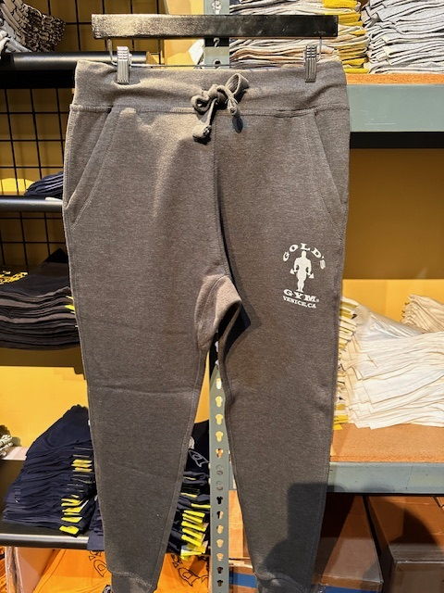
Hanging Bottoms (Men’s):
When half folding bottoms, lay the bottom flat and fold it in half, so the ankle sits just below the waistband, the crotch will face towards the right and the strings should be tied up
The same standard size run suggestion applies to bottoms as well
Typically, when hanging half folded bottoms, even when the fabric is pulled taut, the clips will not be able to be slid to the edge of the hanger, instead, slide them in, only as much as needed, while ensuring each side is evenly distanced
Hanging a product in half vs. hanging it regularly: a regular display is always preferable, as it shows a customer more details of the bottoms. It is easier to identify the item as a bottom and not get overlooked; but a half hung display might be needed due to lack of hanging space *We should never have bottoms dragging on a presentation

Slide 19
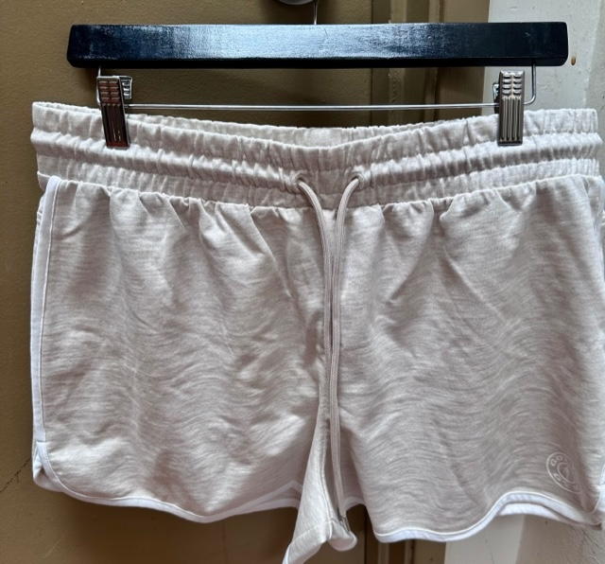
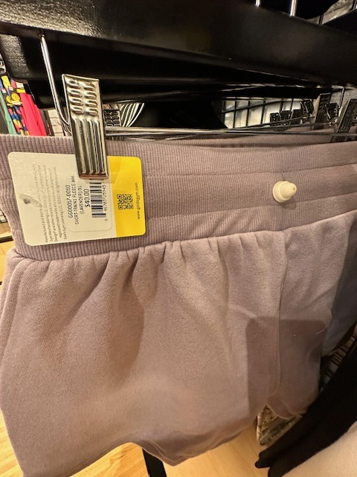
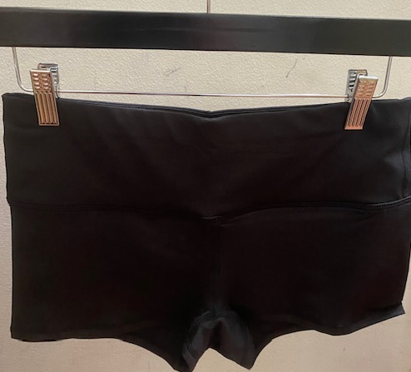
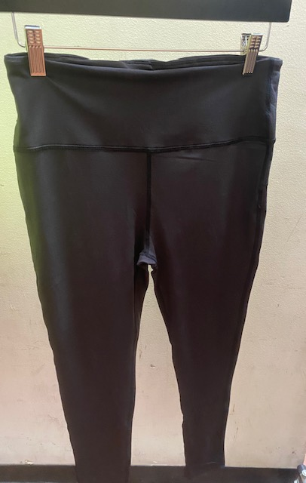
Hanging Bottoms (Women’s):
Any excess fabric that goes beyond the side of the hanger should be even on both sides
As with men’s bottoms, pull the fabric taut, and slide the hanging clips to the edge of the hanger
Tuck the price tag, with the price and size information facing out towards the customer, to ensure easy access to the information and so they don’t rip the tag off trying to get that information. *Also note that the security tag has the round (protruding part) on the outside of the bottom, and the flat part on the inside so that customer can still easily try on our product
Notice: to protect strong hanging standards, the fabric that extends past the hanger and clips is even on both sides and you cannot see the price tag or the sensor

Slide 20
Additional Notes:
Hangers, on a face out, or a rolling rack, should be in the shape of a question mark (?)
When setting product in a wall or floor fixture, always merchandise and set the product from left to right (people shop like they read). This means that smaller sizes should be merchandised the same way (smaller sizes on the left and larger sizes to the right)

Slide 21
Merchandising: Tips and Tricks - Color blocking - Outfitting through merchandising - Detailing - Styling - Accessories

Slide 22
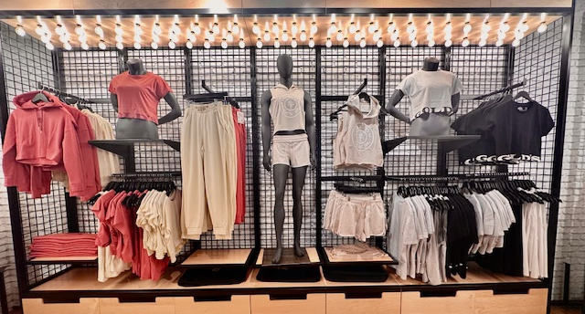
Color Blocking (warm and neutrals):
Using the company’s current POG is always a good place to start when setting product that you have invested in purchasing, but these additional tips and tricks will help, if the POG does not help you when making merchandising decisions based on your current assortment . Color blocking is the first thing to consider when merchandising product in a wall or on floor fixtures . Color blocking is the concept of separating warm and cool colors that are overwhelming to shop when placed together side by side int the same small space. Using a mannequin and/or a neutral color pov (i.e. black, white, and greys) as shown in the photo above is a good way to transition a visual presentation

Slide 23
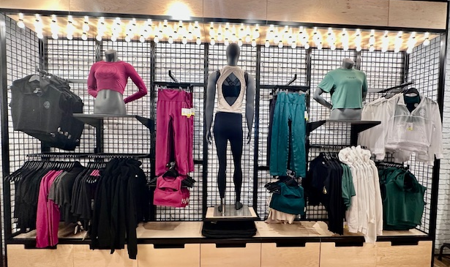


Continued:
This is another example of warm to cool color blocking using a mannequin (with a neutral outfit) to transition from one pov to the other
Mannequin used to transition from warm to cool.
Warm color point of view (pov)
Cool color pov

Slide 24



Color Blocking (floor fixtures):
A corresponding floor fixture that is placed next to another floor fixture can either house the same color pov as shown here (green next to green) or…
The other option is to house a neutral color pov next to a warm or cool color pov such as creams, browns, and/or blacks as shown here
The same rules of color blocking apply to floor fixtures (placed side by side) and the wall bays directly behind the fixtures. The product should be separated from warm to cool, or in an example like this, if there are two strong color points of views (pov) in the same category (cool), separate them, if possible, and then use neutral product to merchandise in to help with outfitting (i.e. grey product with the blue and cream product with the green) *Note directly behind the blue floor fixture there is the same color corresponding as it is with the green floor fixture. It all ties together, which not only is aesthetically pleasing, but it also helps drive revenue by helping customers when picking out outfits

Slide 25


Continued (leveraging neutrals):
Again, a floor fixture placed next to another floor fixture, as pictured here with a rolling rack next to a gondola, should match. As pictured here, this is a neutral rack with creams and black product placed next to a neutral gondola which houses back and white product.
If there is a lot of color being merchandised on the floor fixtures , using neutral colors to merchandise the wall bays helps strengthen the presentation and make the shop less overwhelming
When there is a lot of color shown in the wall bays directly behind a floor fixture, neutral color pov is always a good option to use (black, white, grey, creams, etc.), if you do not have matching colors to use (as shown in the previous slide) *Note the mannequins placed in this grouping are also neutral to protect the color pov

Slide 26


Merchandising Tips and Tricks (negative space):
In this example, accessories are used under the negative space (empty wall space under product or mannequins) in the wall bays. If you have accessories that match the connect of the product in the wall, it is a good option to use to drive additional revenue *Note each mannequin represents the color it is next to in the wall and both are in the same color story *It is not ideal to merchandise a warm and cool color pov on mannequins placed next to each other in a wall or floor fixtures. However, a natural color can be used next to a warm or cool color pov without it clashing
If you do not have accessories, use shelving to make sure there is not too much negative space (white wall space). *Also, note that the first item hanging on the adjacent wall is a transition color (neutral color). All adjacent walls and fixtures should communicate and not “compete” with each other, it all should flow to not overwhelm customers and to drive outfitting/additional revenue

Slide 27


Outfitting to Drive Revenue:
Notice how the entire wall is merchandised in such a way that every item can be exchanged out, based on customer preference, and still be worn together (concept of outfitting). A bottom, top, and piece of outerwear (i.e. jacket or hoodie) is faced out and they are all items with a higher price point to help drive the business. The side hanging product or items placed under the focal/higher price point items, are supporting items that help complete the outfit (i.e. bras, tank tops/tees, etc.) *Note the bra that is merchandised under the white jacket to help show customers how to wear it and encourage them to buy both items
Notice how a mannequin and accessory, both neutral to help with color blocking, are used in this example. Also, notice that the accessory fits the concept of the product in the wall, and it is also merchandised with another accessory to showcase how versatile the bag is to help it sell

Slide 28


Detailing (meant to influence the desire to purchase a product):
As mentioned in previous slides, “pop” the hood up on any hanging product that has a hood to showcase that it has one to a customer…it could be the difference between a sale or someone passing it up to even view. It also creates more hanging space for other product on a face out or a side hanging presentation
On all hanging (or folded) product ensure the price tag is tucked into the product *price tag facing out in such a way that it is easiest for a customer to view if looking. Not tucking it in not only looks aesthetically unpleasing, but also creates the opportunity for tags to get tangled if hanging out next to other tags *Note that hanger spacing is also always being protected when standardizing hanging product
Any time there are strings on hanging product, tie the tag to protect strong merchandising standards and to display to a customer how the product should look when styled on them (influence the purchase)

Slide 29



Detailing Continued:
When hanging more than one item on a face out (never more than two), the product should either be the exact same item in two different colors, or a set such as a matching sports bra and legging set, where the bra does not block the view of the bottom, but instead drives the concept of outfitting and thus increasing a sale
Another demonstration of a matching set on a face out and an accessory placed directly below to not only eliminate negative space, but also enhance a sale via outfitting
Another example, demonstrating not only strong detailing and standards, but also strong outfitting where product and accessories are used to eliminate the negative space below the hanging product. On the left side of the wall, bottoms are quarter folded below the tops and jackets to compete the outfit, and on the right side, bags are used to compete the story

Slide 30



Detailing Continued:
As mentioned, when placing two colors on a face out, as long as the color story is protected, always place the darker color (especially black) behind the lighter color. Black is the number one selling color in retail and will sell no matter where it is placed. It also tends to darken a wall if used too much on a face out and makes the wall less appealing to shop
A strong example of how detailing strengthens a presentation: tags tucked, sensors placed in a seam that is not visible to the customer, and strong hanger spacing. Also, a strong example of outfitting via side hang presentation that can influence and help a customer pick out a full outfit (i.e. tank top, sports bra, shorts, and matching long sleeve top/outerwear) *When setting product in a wall or floor fixture, always merchandise and set the product from left to right (people shop like they read). This means that smaller sizes should be merchandised the same
Hood “popped” and sleeves merchandised as is, but not dragging on the bottom of the wall
An example of the sleeves “scrunched” and styled so they do not drag on the bottom of the wall. Either version works, again, as long as the product is not dragging.

Slide 31


Styling and Mannequin Tips:
In a presentation that is unisex or even if it is a strategic placement, such as the front of a shop to showcase that both male and female product is being sold in the shop, as long as the outfits match, it is okay to merchandise both a male and female mannequin together. Note the color pov and themes match in both examples. While we always want our product to be inclusive to all customers, we also want to make sure we are making the shopping experience as easy to navigate as possible, which is typically why we don’t merchandise male and female mannequins or product together in every presentation
When there is a detail on the hood, especially when it matches the detail on the bottoms, pull the hood up on the mannequin to help encourage the purchase of the entire outfit and set
*Female mannequins typically wear a size small (medium if needed)
When the detailing on the back of an item showcases and helps sell an item and preferably the entire outfit, it is okay to flip a mannequin backwards in a presentation

Slide 32
Additional Mannequin Notes:
Female mannequins typically wear a size small, medium if needed
Male mannequins typically wear a size large, extra large if needed
If you need to size up when dressing a mannequin, to highlight an item you want represented, a binder clip can be used on the back of the shirt (on the inside) to “sinch” the top and give it a better fit
Make sure the outfit is steamed, the sensors are removed from the product, and if needed, a lint roller is used to refresh the items
When dressing a mannequin, completely remove it from its base, remove all the limbs that can detach from the mannequin (you will see a seam where it detaches) and lay it on a flat and covered surface to protect the mannequin from being scratched, broken, or the plaster chipping
When the mannequin is dressed and it is placed back on its base, style the product in a way that you would see an outfit styled *this is to inspire a customer to purchase the entire look. An example of this includes, but is not limited to:
Tucking a longer tee or tank into one side into the bottom
Using the “3 piece” rule, when possible, which means that a bottom, top, and third piece/outerwear is represented (you can even show a third piece tied around the waist of a mannequin as a styling technique as shown in the photo above)

Slide 33
Accessories

Slide 34





Accessories (placement):
Grouping in such a way that all of the product in the same “family” is in one place (i.e. all shaker bottles), especially when there are multiple price points and color options is a strong way to merchandise accessories
Leveraging all surfaces on a floor fixture, such as a gondola, as shown, as long as all of the product has a similar theme helps to drive sales and leverage every inch of selling square footage in your shop, if needed. *Note that the supplements on the front of the fixture go from small to large on the bottom. Merchandising larger product on top can be overwhelming and block the view/discourage customers from seeing the variety of sizes and options of product offered
As shown in previous slides, accessories can be used under product in walls or fixtures to not only eliminate negative space, but also, to help drive outfitting and revenue
In this example, wall bays are used to not only transition product in a wall presentation, but also to drive outfitting and complete the outfit

Slide 35


Protein bars
Smaller items
Protein powder
(like items)
Larger items
Combining like accessories together *all protein
Another example of accessories merchandised together with smaller items on top and larger items on the bottom

Slide 36
Sensor Guidelines *Advise on using sensors with product $30 and above

Slide 37



Sensor Guide:
Always sensor product in the seamline as it is the most stable place in the product that will ensure that the product is not damaged by the product with a hole or puncture marks
It is helpful for your team to sensor items in the same spot, whenever possible, so they don’t forget to check to remove it when ringing up a customer. *Exception to this is when folding and stacking product…see note at the end of the next picture →
Again, always check for the strongest seam in the item when placing the sensor, which differs with different items and fabrics. *Note when sensoring product that is folded vs. hung, folded product uses a technique called “waterfalling” where you switch from left side to right and from the bottom of the item, moving towards the top of the item, so the stack lays as flat as possible and doesn’t topple

Slide 38




Sensor Guide Continued:
With seamless product, there is typically only one seam, at the neckline, that is strong enough to hold a sensor. Whereas most other tops, can do it on the side, where it is less invasive for customers when trying product on
As previously mentioned, especially when having to place a sensor in the neckline, place the flat side of the sensor inside so customers still can comfortably try product on

Slide 39
Sale

Slide 40



Sale (examples):
If you have the space, separate male and female product, and always represent your newest markdowns, with the highest price point
If possible, leverage a wall or floor fixture to house sale/markdown items together, so customers know where to go to find sale items. It is okay to group male and female product together in the same wall or fixture (but keep it separate, as shown above). It is also okay to leave the tag out on sale items, as customers frequently tug and pull the tags to see the sale price as quickly and easily as possible. However, if tags are getting tangled, or your wall is very focal, tuck the tag, as with regular price items
Leverage a face out to place sale marketing on *this keeps the presentation subtle, while still easily highlighting where sale product is located

Slide 41


Sale (promotions):
As long as the promotional marketing is clear, do not take a wall apart and merchandise it like sale, as the workload is not necessary for a temporary discount and the difference between sale and promotion should be clear
When running a promotion, leave product in place, and clearly place your promotional marketing

Slide 42
Additional Sale Notes:
Placing a sale presentation towards the back of the store, is a strategic move, as full price should always be the most focal product. It also helps drive traffic from the front of the store towards the back, as sale is often the most frequently sought after product, but if you can get a customer to walk all the way through the store, you have a better chance at converting them to newer product they might have missed
Whenever possible, keep your sale wall or fixture stationary so your customers always know where to find it
Make sure your sale marketing is visible, but not so large or distracting to take away from your full price items or marketing. Reference photos to see how to subtly, yet clearly place sale marketing

Slide 43
Tools and Links

Slide 44



Supplies (Amazon):
- Clear bins
- Towers for concessions

Slide 45
Supplies Continued (supplier links):
- Shelving
- Face outs
-Side hang bars
- gondolas
- Rolling racks
- Core towers
- Hangers

